Slide 1
205 Feb 2, Class 13
Assefi & Garry (2003)
Chapter 11: Sampling and Generalizability

Slide 2
Absolut Memory Distortions
Can the simple suggestion that you have consumed alcohol affect your memory for an event? Alcohol placebos affect social behaviors, but not non-social ones, and have not previously been shown to affect memory. We investigated the effect of alcohol placebos using materials that revealed both the social and the nonsocial influences of memory. Subjects drank plain tonic water, but half were told it was a vodka and tonic; then all subjects took part in an eyewitness memory experiment. Subjects who were told they drank alcohol were more swayed by misleading postevent information than were those who were told they drank tonic water, and were also more confident about the accuracy of their responses. Our results show that the mere suggestion of alcohol consumption may make subjects more susceptible to misleading information and inappropriately confident. These results also provide additional confirmation that eyewitness memory is influenced by both nonsocial and social factors.

Slide 3
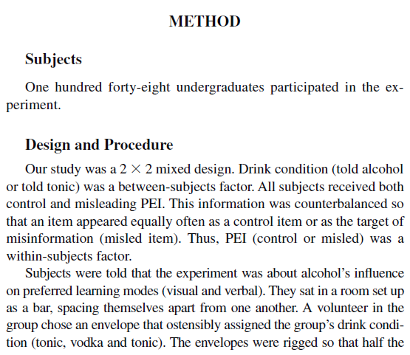
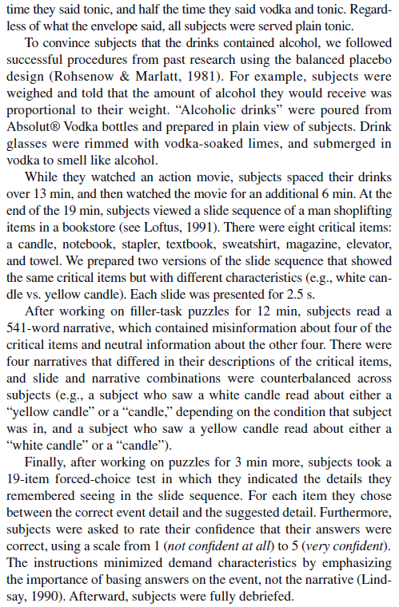

Slide 4
Assignment questions
What are the two factors and levels of each factor in the design?
What is the main dependent variable of the design?
What are the 3 hypotheses tested by this factorial design?
What kind of interaction is shown in Figure 1?

Slide 5
Diagram
2x2 mixed design
Placebo/control between groups
Misleading/control information within groups
148 original participants (31 eliminated)
74 subjects per group planned
 | Misleading PEI | Control PEI
Alcohol placebo | N=74 1.45 | N=74 2.45
Control | N=74 1.80 | N=74 2.50

Slide 6
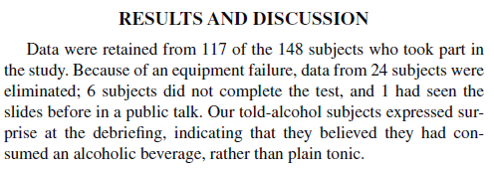
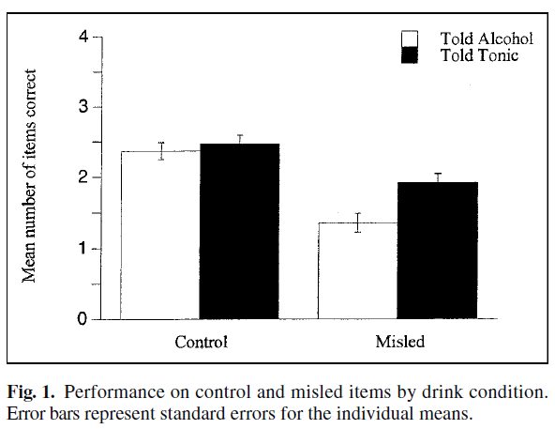

Slide 7
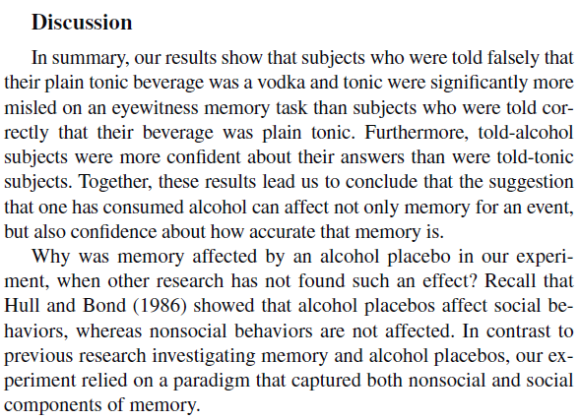

Slide 8
Research sampling
Terms
Sample: participants, the people who actually participated in your study
Population: the general collection your participants were drawn from
Statistics
Measurements of your sample are noisy estimates of what you would get from measuring everybody in your population
Mean, SD are population descriptions
SE, Standard Error, is estimate of accuracy of your sample measurements

Slide 9
Recruiting participants
Convenience sampling
Collecting data from available people around you
University undergraduates
Course credit for participation, 3-10 hours
Paid participants
Departmental PPR: Paid Participant Registry
Mailing list of participants who expressed interest in participation opportunities
Posted flyers around campus
Paid ads
Other online sources: Mechanical Turk, Prolific

Slide 10
Ethics in Research Advertising
All recruiting materials must be reviewed by the IRB
All posted flyers should have an approval stamp
Accuracy of description
What if the experiment includes some deception?
Ad is necessarily shorter than a consent form
Compensation and coercion
Paying too much is a concern
Competition among researchers discouraged
But no published standard guidelines exist

Slide 11
Coercion in recruiting
No participant in a research study should ever feel threatened into participating
Loss of employment concerns
Lab staff members cannot be recruited
Loss of educational access
Loss of medical benefits access
Studies with substantial risk often pay more
Concerns about implicit coercion of poor participants
IRB judges the balance of risk/compensation

Slide 12
External validity
Are we confident that the results of the findings with the sample apply to the whole population?
Internal validity
Are we confident the IV is responsible for the DV effect we measured?
Experimental research: excellent internal, mediocre external
Non-experimental research: weak internal, excellent external

Slide 13
Sampling bias
Could the recruiting method lead to a non-representative sample?
Recruiting by ad
“Do you like puzzles?”
“Research on stereotypes and bias”
“Study on memory!”
Brain imaging, EEG...
If the sample is biased
Internal validity stays high
External validity may be limited

Slide 14
Limitations on external validity
The research results may not apply to the whole population
They still apply to similar samples (restricted population)
Who doesn’t it apply to?
Why?
Implicit limitations
Effects rarely assumed to apply across whole age range
Not assumed to apply to constrained subpopulations
What sampling issues do we have to consider with our in-class experiment methodology?

Slide 15
WEIRD Samples
Western
Educated
Industrialized
Rich
Democratic
Undergraduates from expensive universities in the USA, Canada, Western Europe
When does this subpopulation exhibit different psychological phenomena than the broader population?

Slide 16
Online research
Online marketplace to connect volunteers to researchers
Potential to be less WEIRD
Still somewhat restricted
Not well-integrated into oversight processes for research
Identity authentication is hard
Bots, multi-accounts, shared accounts
Little accountability for researchers about privacy, compensation, fairness
Practically seems to work very well
No major issues seem to have occurred to date

Slide 17
For Monday 2/5
Preliminary analysis of Experiment 2 data
Handbook/recipe for running ANOVA in R posted on Canvas
Wednesday
Writing in APA format: Introduction, Discussion
Friday
Writeup #2 due

Slide 18
The grass is always greener on the other side
Design a 2x2 between-participants factorial experiment to test the everyday meaning of this aphorism.
Use subjects high and low in optimism as one factor in the design.
Give predicted results consistent with the idea that the grass on the other side will look greener and it will look particularly greener to optimists.

Slide 19
 | Near | Far
Optimists
Pessimists
6.5
9.7
6.5
8.2

